Slide 1
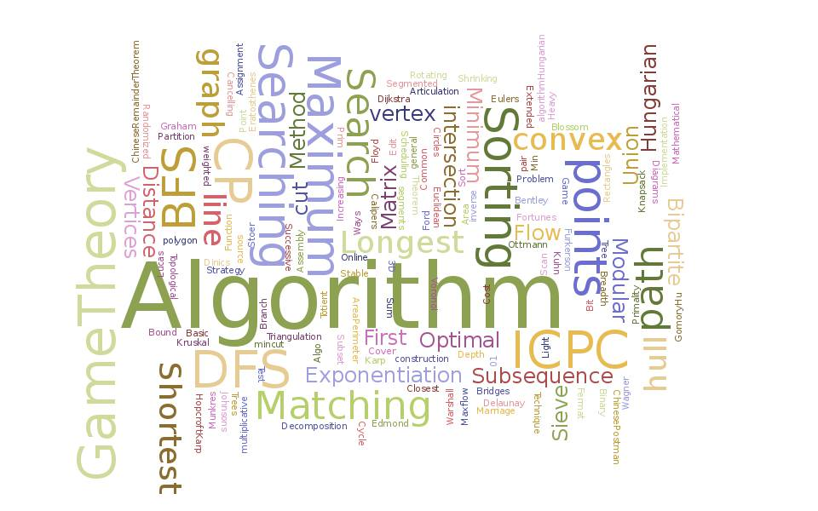
Algorithm Analysis
and Design
ETCS-301
Dr. Deepak Gupta
Computer Science & Engineering
Maharaja Agrasen Institute of Technology, Delhi (GSIPU)
Email: drdeepakgupta.cse@gmail.com, deepakgupta@mait.ac.in

Slide 2

Syllabus
Unit-I
Introduction to Algorithm analysis and design, Asymptotic notations(O,Ω,Ɵ),Time and Space complexity, Little-oh and little omega notations, Complexity analysis :Insertion sort, Recurrence relations: iteration method, Recurrence relations: recursive tree method, Recurrence relations: substitution method, Recurrence relations: Master’s method, Recurrence relations: Subtract and conquer Master’s method, Data structures for Disjoint sets, Medians and order of Statistics, Complexity analysis: Quick sort, merge sort, Strassen’s algorithm for matrix multiplication.
Unit-II
Dynamic programming: ingredients, Binomial coefficient computation, Matrix chain multiplication problem, Longest common subsequence problem, Optimal binary search tree problem, 0-1 knapsack problem, Floyd Warshall algorithm, Some other problems on dynamic programming.
Unit-III
Greedy algorithms: elements, local and global optima, matroid, Activity selection, fractional knapsack problems, Huffman codes, Task scheduling problem, Minimum spanning tree: Prim’s algorithm , Kruskal’s algo, Dijkastra and Bellman Ford algorithm
Unit-IV
String matching algorithms: Naïve string matching, Rabin Karp string matching, String matching with Finite automata , Knuth Morris Pratt string matching, Polynomial time verification, NP completeness and reducibility, NP completeness Proof, Case study of NP Complete problems: Vertex cover and Clique problems

Slide 3

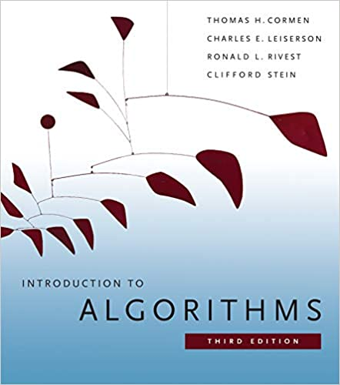
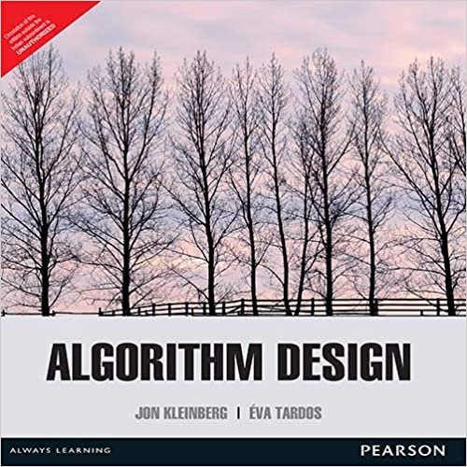
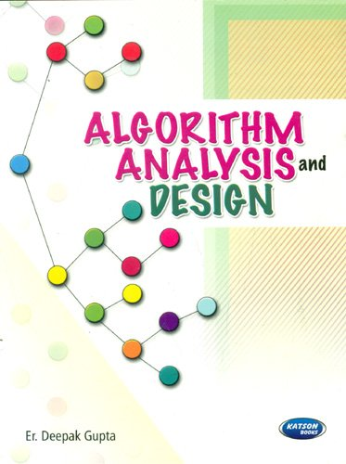
Books
[T1] T. H. Cormen, C. E. Leiserson, R. L. Rivest, Clifford Stein, “Introduction to Algorithms”, 3rd Ed., PHI, 2013.
[T2] Jon Klenberg, Eva Tardos,”Algorithm Design”, Pearson Publications,2014
[Suggestion] Deepak Gupta, “Algorithm Analysis and Design”, Katson Publications, 2016

Slide 4
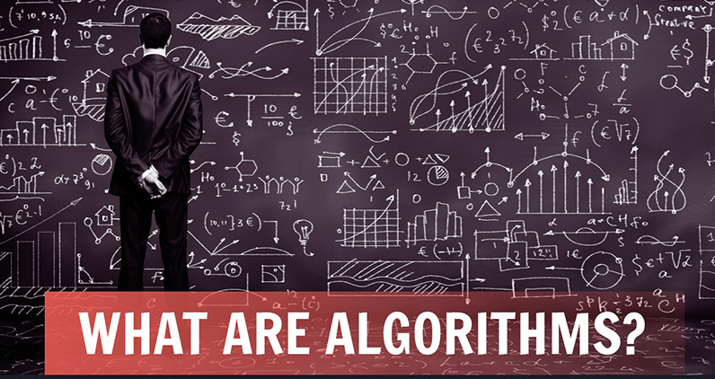
An algorithm, named after the ninth century scholar Abu Jafar Muhammad Ibn Musa Al-Khowarizmi, An algorithm is a set of rules for carrying out calculation either by hand or on a machine.
1. Algorithm analysis and design is a branch of computer science that consists of designing and
analyzing computer algorithms The “design” pertain to
i. The description of algorithm at an abstract level by means of a pseudo
language, and
ii. Proof of correctness that is, the algorithm solves the given problem in
all cases.
2. The “analysis” deals with performance evaluation (complexity analysis).
The complexity of an algorithm is a function g(n) that gives the upper bound of the number of operation (or running time) performed by an algorithm when the input size is n or in other words complexity of an algorithm is calculated using growth functions.

Slide 5
Properties of Algorithm
Input
Output
Definiteness
Completeness
Efficiency

Slide 6

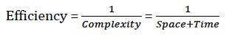
Efficiency?
A solution is said to be efficient if it solves the problem within its resource constraints
Space
Time
The cost of a solution is the amount of resources that the solution consumes
Relation between Efficiency and Complexity.
Notes:
Alternate definition: Better than known alternatives (“relatively efficient”).
Space and time are typical constraints for programs.
This does not mean always strive for the most efficient program. If the program operates well within resource constraints, there is no benefit to making it faster or smaller.

Slide 7
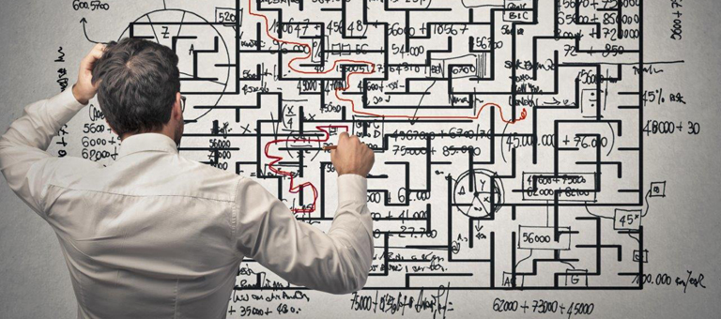
Complexity?
Complexity of an algorithm means predicting the resources which are required by an algorithm to perform its task. It is measured in terms of space and time complexity.
Space complexity:
The total amount of computer memory required by an algorithm to complete its execution.
Time complexity:
The total amount of time required by an algorithm to complete its execution.

Slide 8
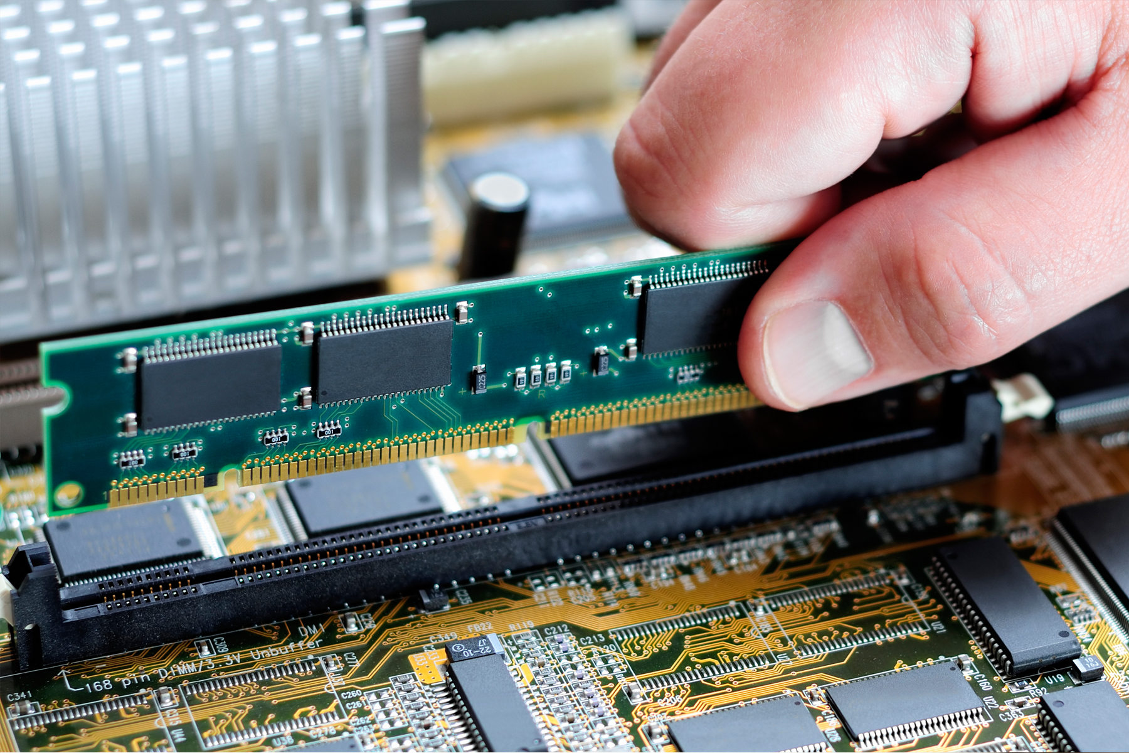
Space Complexity
When a program is under execution, it uses the computer memory as:
Instruction space
Environmental stack
Data space
During performance analysis which is based on space complexity, we will only consider data space i.e. memory required to store constants, variables, structures etc.

Slide 9

Example: space complexity calculation
int square (int a)
{
return a*a;
}
It requires total 4 bytes of memory
Also known as constant space complexity
int sum (int A[], int n)
{
int sum=0, i;
for (i=0;i<n;i++)
sum=sum+A[i];
return sum;
}
It requires total 2n+8 bytes of memory
Also known as linear space complexity

Slide 10

Time Complexity
Running time of an algorithm depends on the following:
Whether it is on single or multi processor machine
Whether it is 32 or 64 bit machine
Read and write speed of machine
Time it takes to perform arithmetic, logical operation, return value and assignment operation etc.
Input data
During time calculation, we will only consider input data i.e. for different input values how the program behaves in order to perform all the operations like arithmetic, logical, return, assignment etc.

Slide 11

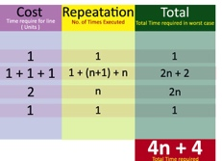
Example: time complexity calculation
int sum (int a, int b)
{
return a+b;
}
It requires total 2 units of time
Also known as constant time complexity
int sum (int A[], int n)
{
int sum=0, i;
for (i=0;i<n;i++)
sum=sum+A[i];
return sum;
}
Also known as linear time complexity

Slide 12
Algorithm Analysis
and Design
ETCS-301
Dr. Deepak Gupta
Computer Science & Engineering
Maharaja Agrasen Institute of Technology, Delhi (GSIPU)
Email: drdeepakgupta.cse@gmail.com, deepakgupta@mait.ac.in

Slide 13
Sample(n)
{
For (i=0; i<n; i++)
{
Printf(“%d”, i);
}
For (j=0; j<n; j++)
{
Printf(“%d”, j);
}
}
Cost | Repetition | Total
1+1+1 | 1+(n+1)+n | 2n+2
1 | n | n
1+1+1 | 1+(n+1)+n | 2n+2
1 | n | n
 |  | 6n+4

Slide 14
Mat_Add(A, B, C, m, n)
{
For (i=0; i<n; i++)
{
For (j=0; j<n; j++)
{
C[i,j] = A[i,j]+B[i,j];
}
}
}
Cost | Repetition | Total
1+1+1 | 1+(n+1)+n | 2n+2
1+1+1 | (1+(m+1)+m)n | 2mn+2n
2 | m*n | 2mn
 |  | 4mn+4n+2

Slide 15
Mat_Sam(A, B, C, n)
{
For (i=0; i<n; i++)
{
For (j=0; j<n-i; j++)
{
C[i,j] = A[i,j]+B[i,j];
}
}
}
Cost | Repetition | Total
1+1+1 | 1+(n+1)+n | 2n+2
1+1+1 | (1+(n-i+1)+(n-i))n | 2n^2+2n-2ni
2 | n*(n-i) | 2n^2-2ni
4n^2+4n-4n^2+4n+2=8n+2, i=n-1 4n^2+4n+2, i=0 |  | 4n^2+4n-4n*i+2

Slide 16
Mat_Sam(A, B, C, n)
{
For (i=0; i<n; i++)
{
For (j=0; j<n-i; j++)
{
C[i,j] = A[i,j]+B[i,j]; ….. Summation of (n-i) with i = 0 to n-1
}
}
}

Slide 17
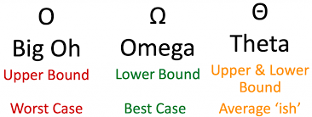
Space complexity space taken by an algorithm
Time complexity time taken by an algorithm
The best case complexity of the algorithm is the function defined by the minimum number of steps taken on any instance of size n.
The worst case complexity of the algorithm is the function defined by the maximum number of steps taken on any instance of size n.
The average-case complexity of the algorithm is the function defined by an average number of steps taken on any instance of size n. Each of these complexities defines a numerical function - time vs. size.

Slide 18

Rate of Growth
Order of Time
1 | Constant Time
Log n | Logarithmic Time
N | Linear Time
N² | Quadratic Time
N³ | Cubic Time
2^{n} | Exponential time

Slide 19
Asymptotic Notations
These are languages that allow us to analyze an algorithm's running time by identifying its behavior as the input size for the algorithm increases. This is also known as an algorithm's growth rate.
Types
Big Oh (‘O’) – represents maximum time
Omega (‘Ω’) – represents minimum time
Theta (‘θ’) – represents average time
Little oh (‘o’) – variation of Big Oh notation
Little omega (‘w’) – variation of Omega notation

Slide 20
Big Oh (O)
It is used in Computer Science to describe the performance or complexity of an algorithm. Big O specifically describes the worst-case scenario, and can be used to describe the execution time required or the space used (e.g. in memory or on disk) by an algorithm.
F(n) = O(g(n)), represents the maximum time g(n) for the given function F(n) which satisfies the conditions i.e. c>0, n>=n0.
F(n) <= c*g(n) for all c>0 and n>=n0.
It is also known as asymptotically upper bound.

Slide 21
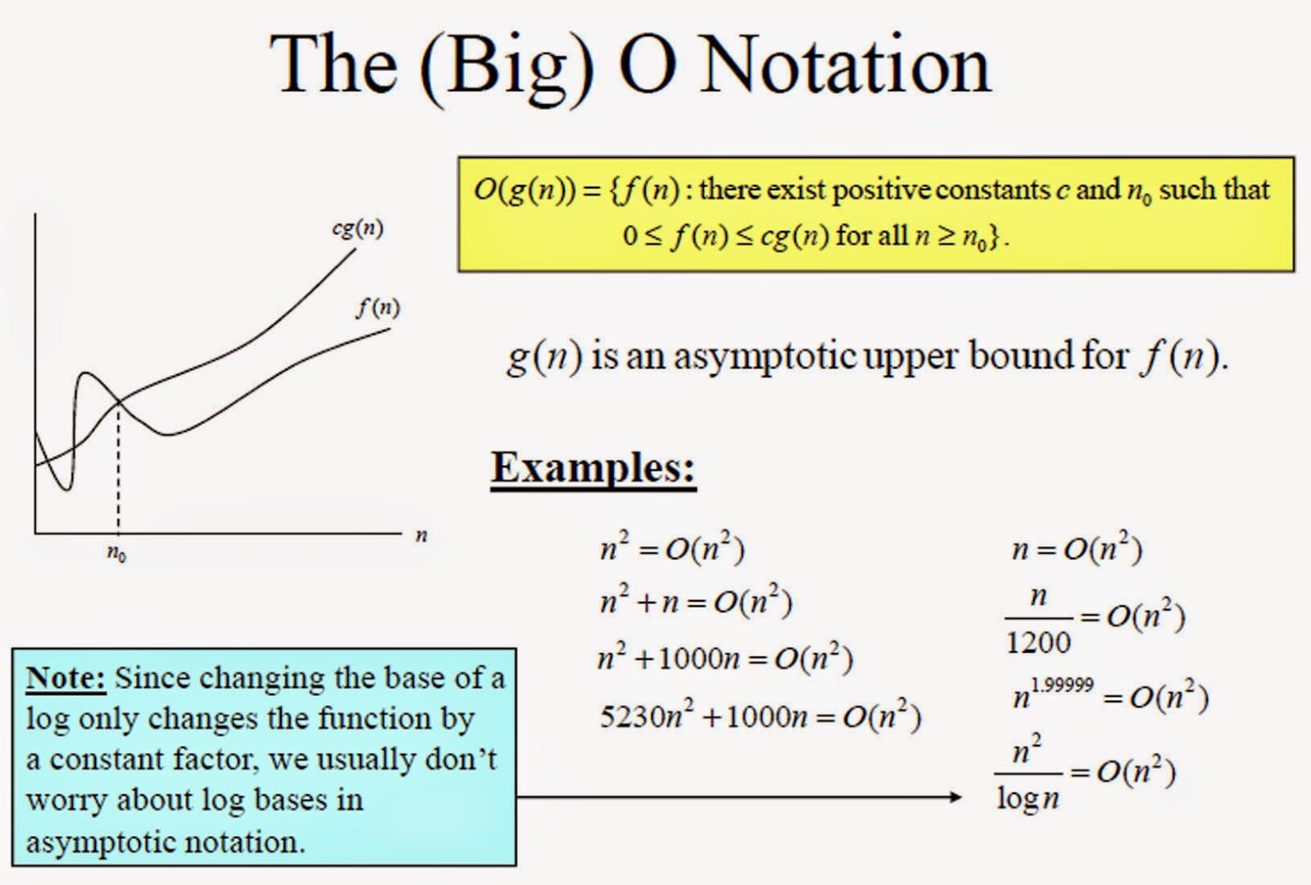

Slide 22
Examples
Ques. Prove or Disprove the following?
(a) 2^{n+1} = O(2^{n}) (b) 2^{2n} = O(2^{n})
F(n) = 2^{n+1}
F(n) = 2^{n} *2
F(n) = 2^{n} * C for C=2
F(n) <= 2^{n} * C for all C>=2
Hence 2^{n+1} = O(2^{n})
F(n) = 2^{2n}
F(n) = 2^{n} *2^{n}
F(n) = 2^{n} * C for C=2^{n}
F(n) <= 2^{n} * C for all C>=2^{n}
Hence 2^{n+1} ≠ O(2^{n})

